Slide 1
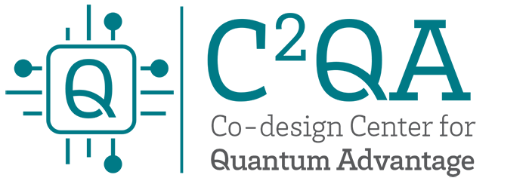

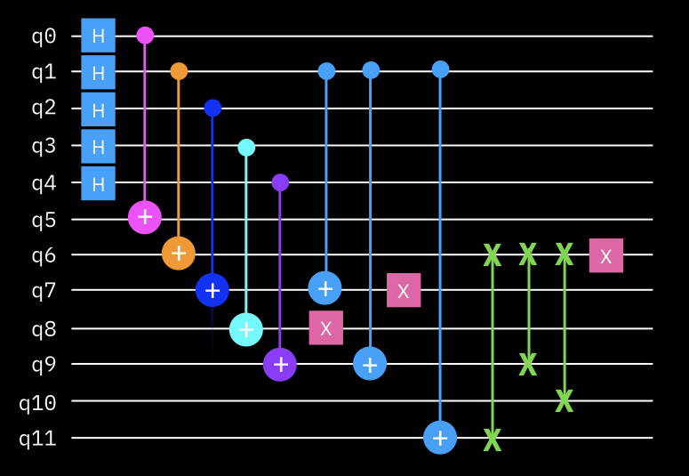
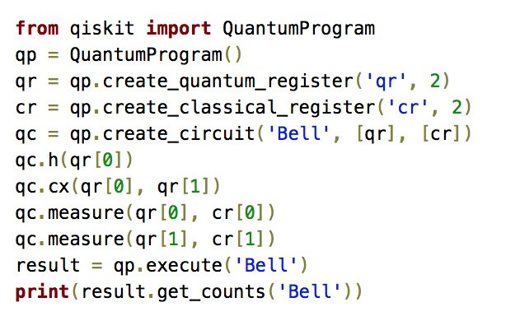
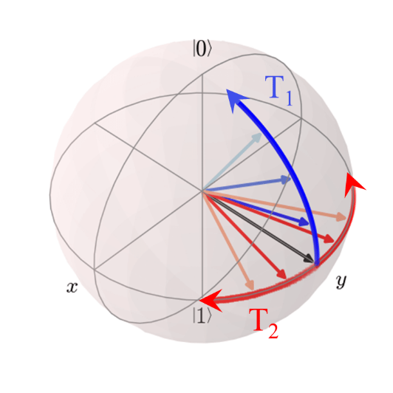

Foundations of
Quantum Computing
(QIS 301)
Dave Biersach
Brookhaven National Laboratory
dbiersach@bnl.gov
Session 02
Installing Python and Development Tools
(Double Period)

Slide 2
Agenda
Installing Git, Python, and Visual Studio Code
Windows Users:
Installing PowerShell and Windows Terminal
Checking for prior Python installations
Mac Users:
Running Terminal with Rosetta (M1 Macs Only)
Creating a Python Virtual Environment (~ 10 steps)
Configuring Visual Studio Code Extensions
Running Python scripts in VSCode
How To Learn More about Git and Virtual Environments

Slide 3
What We Are About To Do
The next three slides will cover how to install the following software (in this order) on your local (privately-owned) PC:
Git - https://git-scm.com/downloads
The courseware is at https://github.com/dbiersach/qis301-labs
You must install Git now and will later clone that repository
Python - https://www.python.org
You must install Python 3.8.9 or 3.8.10 (recommended)
You cannot use Python series 3.7 or series 3.9
You need the 64-bit version of Python 3.8
VS Code - https://code.visualstudio.com

Slide 4
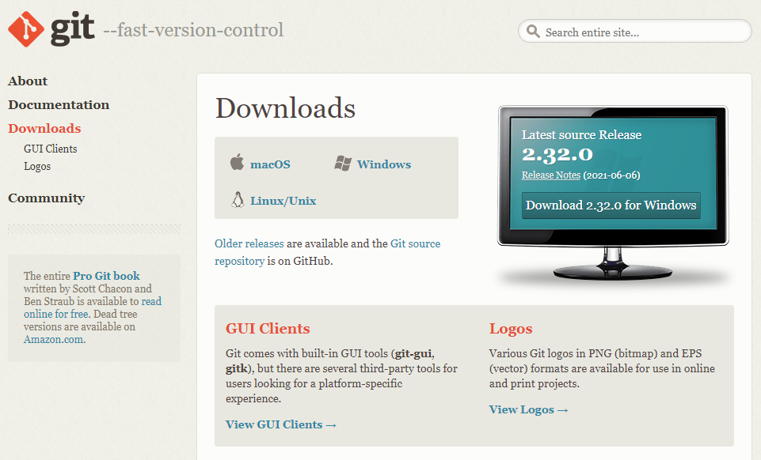
Installing Required Software – Step 1
https://git-scm.com/downloads
Accept any default settings

Slide 5
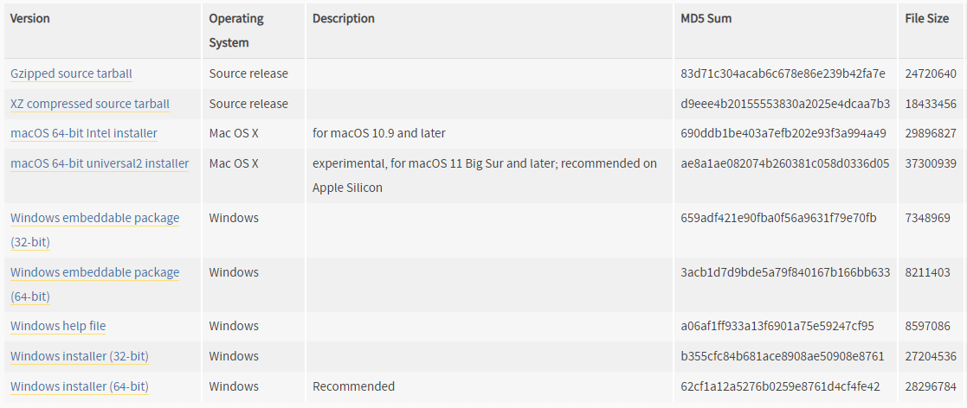
Installing Required Software – Step 2
https://www.python.org/downloads/release/python-3810

Slide 6
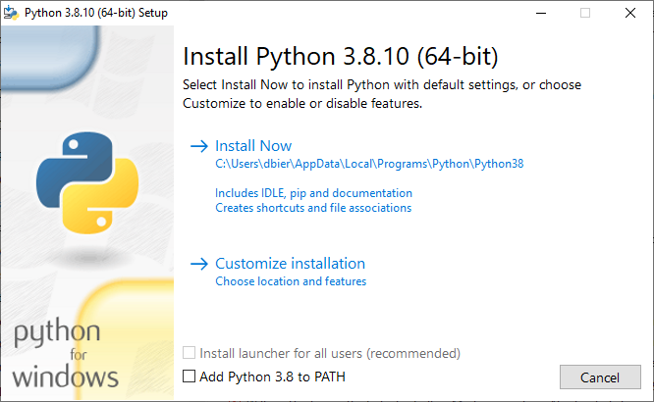
Installing Required Software – Step 2
https://www.python.org/downloads/release/python-3810
Be sure this is unchecked!

Slide 7
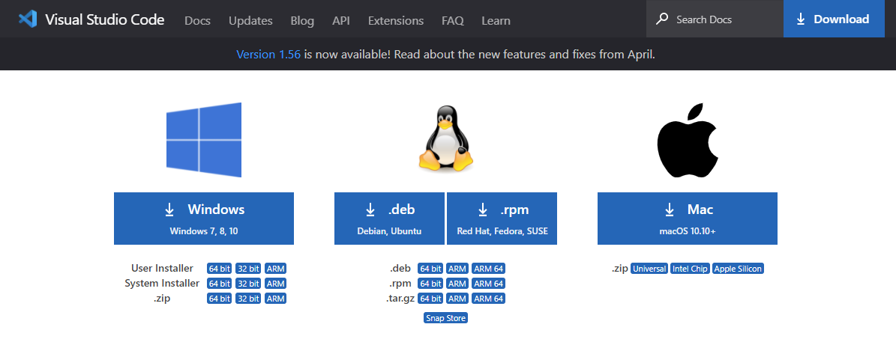
Installing Required Software – Step 3
https://code.visualstudio.com/download
Accept any default settings

Slide 8
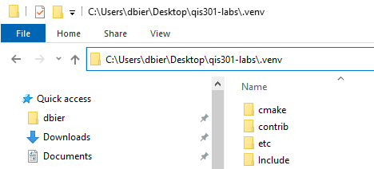
Virtual Environments in Python
Each Python virtual environment (which is just a folder) you create will contain a complete stand-alone copy of the entire Python toolset and any modules you install…
… so, when you activate a virtual environment, you are isolating changes, so they affect just that one environment, not your whole system.
You will now create a Python virtual environment for qis301, based upon your local OS…

Slide 9
For Windows Desktops
You must install Windows Terminal and PowerShell
Windows Terminal can be installed from here: Microsoft Store
PowerShell can be installed from here: Microsoft Store
Verify you have Python 3.8 installed
Don't depend on your PATH to find the needed Python 3.8
On Windows, Python interpreters are normally stored at:
~/AppData/Local/Programs/Python
The next screen shows how to test your Python 3.8 install
Enter the following commands into Windows Terminal (PowerShell)
You cannot use the old Windows "Command Prompt" !!

Slide 10
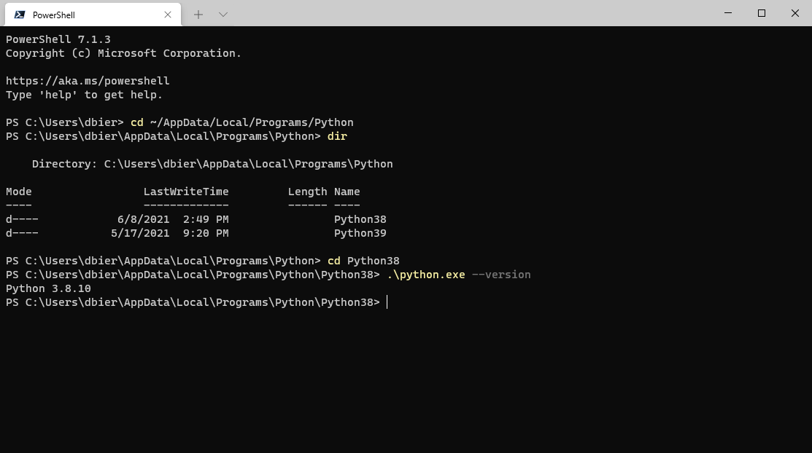
For Windows Desktops
①
②
Double hyphen
③
④
Success!
If you don't have 3.8 installed, please go to https://www.python.org
and install 3.8.10 (not the latest 3.9+ version!)

Slide 11
For Windows Desktops
In the Windows Terminal (PowerShell), please enter these 12 commands in this sequence, pressing Enter at the end of each command, as shown in the next four slides:
cd ~/Desktop
git clone https://github.com/dbiersach/qis301-labs
cd ~/AppData/Local/Programs/Python/Python38
.\python -m venv $HOME/Desktop/qis301-labs/.venv
cd ~/Desktop/qis301-labs
Set-ExecutionPolicy -Scope CurrentUser RemoteSigned
.venv/scripts/activate
python -m pip install --upgrade pip
pip install --upgrade setuptools
pip install --upgrade wheel
pip install -r requirements.txt
code .

Slide 12
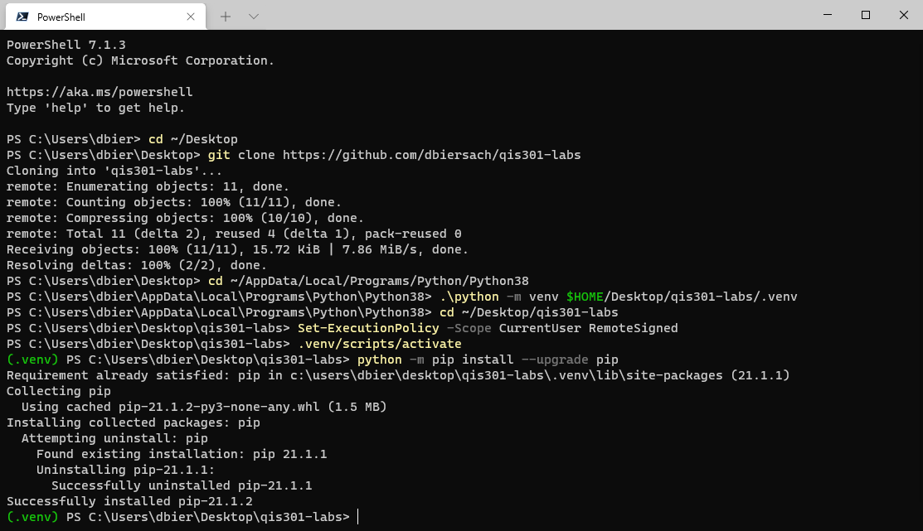
For Windows Desktops
Commands
1…8
①
②
③
④
⑤
⑥
⑦
⑧
Note: your output may not look exactly like this, but you should not get any errors

Slide 13
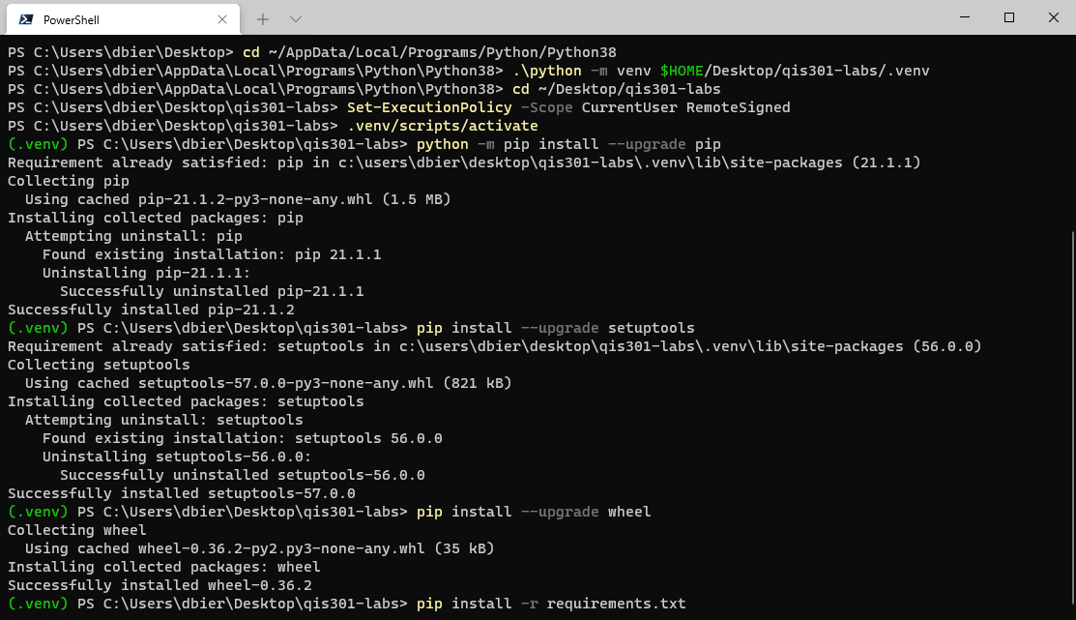
For Windows Desktops
Commands
9…11
⑨
①⓪
①①
Note: your output may not look exactly like this, but you should not get any errors

Slide 14
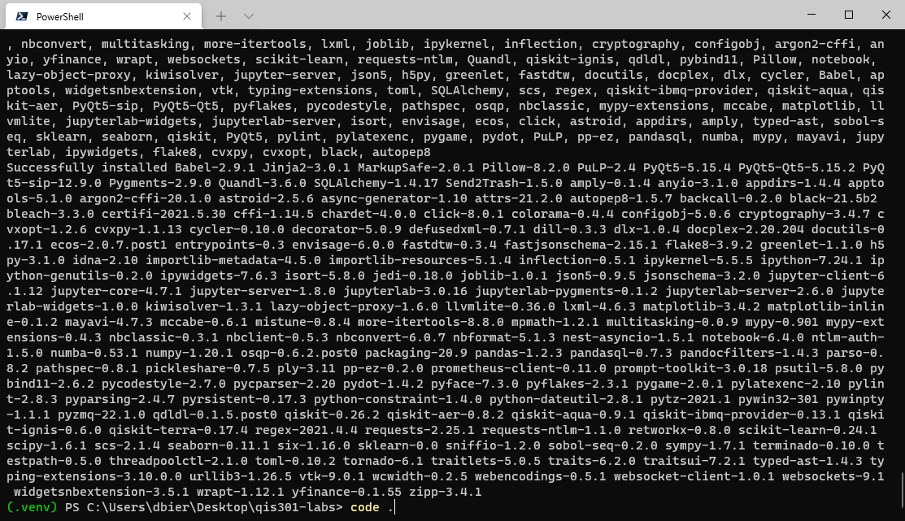
For Windows Desktops
If you get any errors in the final command #11, please try running the same command #11 again:
pip install -r requirements.txt
Success!
To launch Visual Studio Code in the labs folder,
type this command and press Enter:
code .
(Note: there is a space between the word "code" and the period)

Slide 15
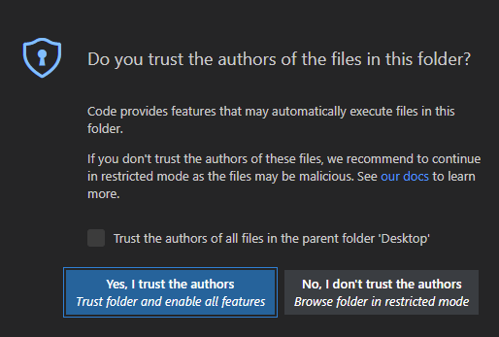
For Windows Desktops

Slide 16
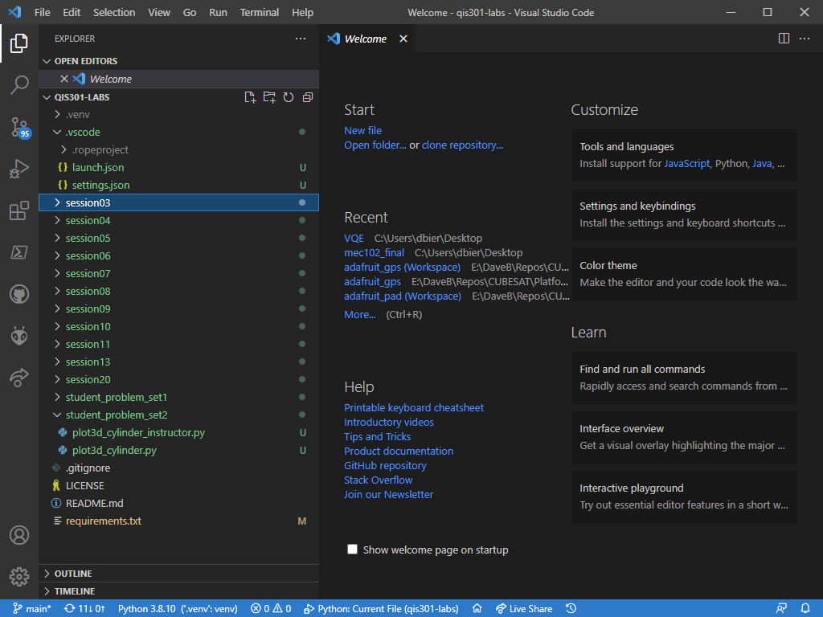
For Windows Desktops
Success!

Slide 17
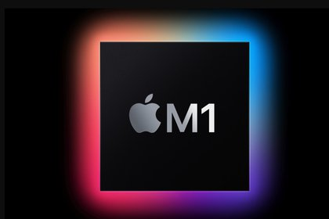
For macOS (M1) Desktops
Only if you have a new M1 generation MacBook or Mac Mini, that runs on the Apple Silicon (ARM) CPU, will you need to configure Terminal to run in Rosetta mode
The Python community is hard at work making native M1 CPU (ARM) compatible builds available at https://pypi.org
However, right now most of the Python packages needed for this workshop are not M1 compatible
Therefore, to force Python to download the older CPU code for the Intel x86-64 packages, you must set the Apple Terminal to use Rosetta to emulate the Intel CPUs
To do this, follow the steps on the next two slides:

Slide 18
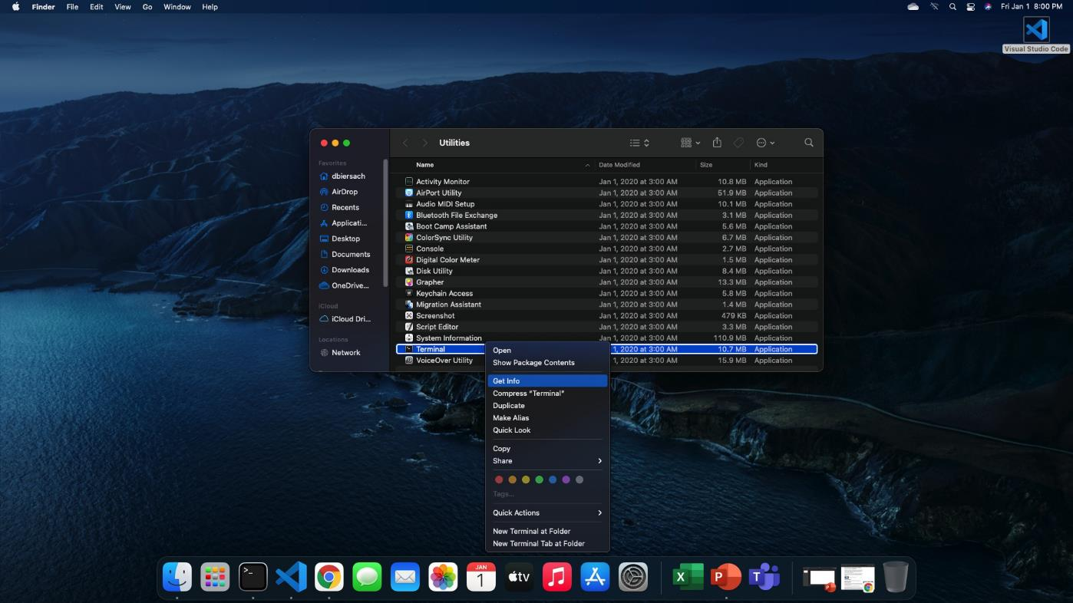
For macOS (M1) Desktops
Second, CTRL + Click
(Right Click) on the Terminal app in the Finder
First, CMD + Click the Terminal icon in the Dock
Third, click the "Get info" menu option

Slide 19
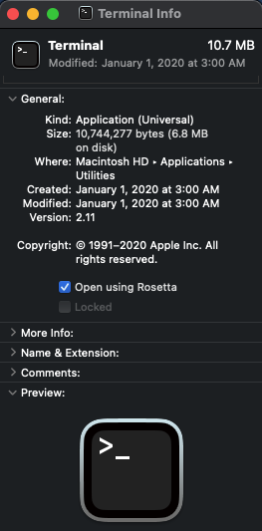
For macOS (M1) Desktops
Fourth, click
"Open using Rosetta"
Fifth, restart the Terminal app

Slide 20
For macOS (all) Desktops
In the Terminal app, please enter these 10 commands in this sequence, pressing Return at the end of each command, as shown in the next three slides:
xcode-select –install
cd ~/Desktop
git clone https://github.com/dbiersach/qis301-labs
cd ~/Desktop/qis301-labs
/usr/local/python3.8 –m venv .venv
source .venv/bin/activate
python -m pip install --upgrade pip
pip install --upgrade setuptools
pip install --upgrade wheel
pip install -r requirements-mac.txt
code .
{no worries if already installed}
{not requirements.txt}

Slide 21
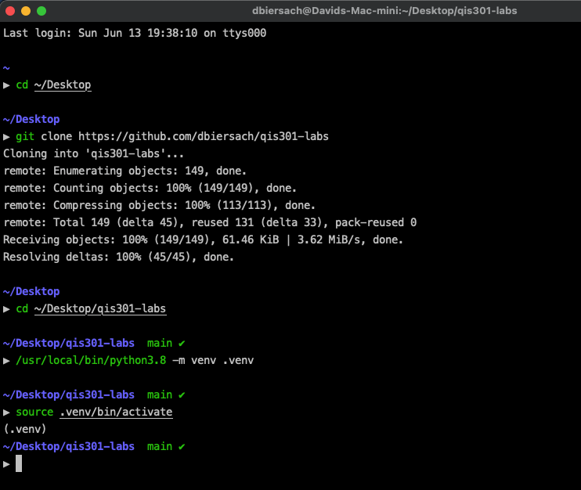
For macOS (all) Desktops
①
Commands
1…5
②
③
④
⑤

Slide 22
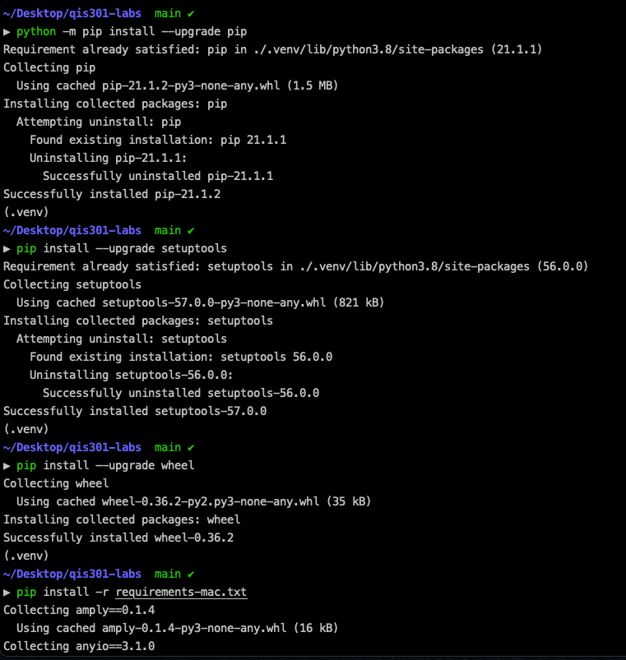
For macOS (all) Desktops
⑥
Commands
6…9
⑦
⑧
⑨

Slide 23
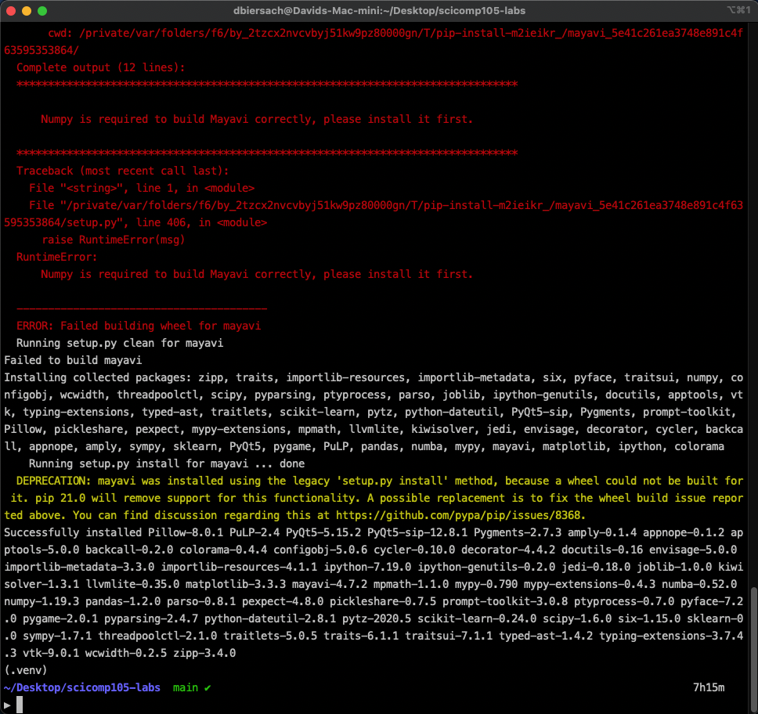
For macOS (all) Desktops
If you get an error, just rerun command #9
pip install -r requirements-mac.txt
Success!

Slide 24
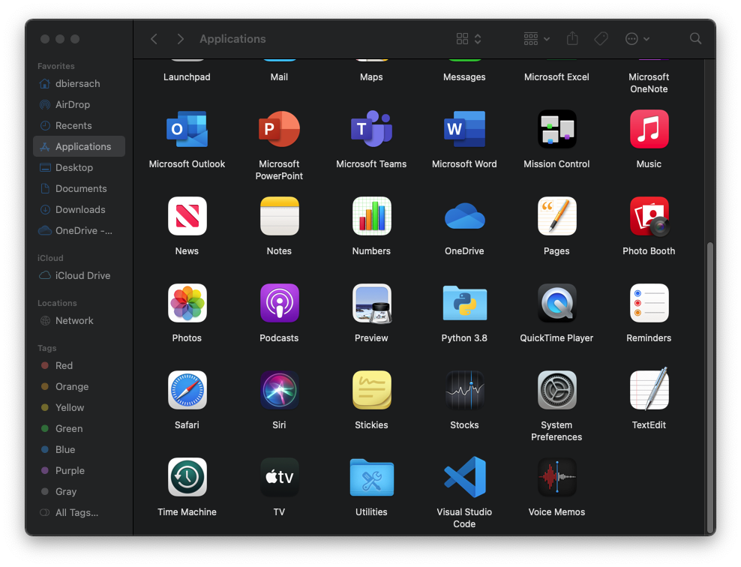
For macOS (all) Desktops
Move Visual Studio Code into your Applications folder and launch it

Slide 25
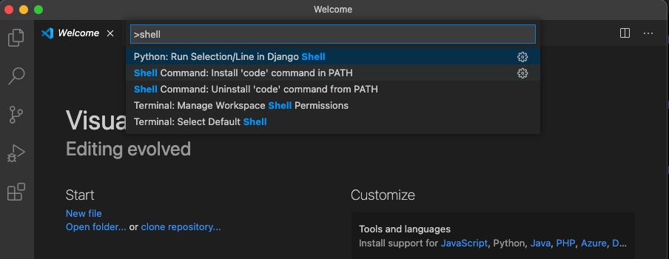
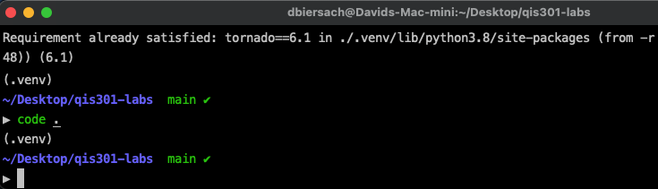
For macOS (all) Desktops
Press SHIFT+CMD+P, type shell and select 'Install code command in PATH'
You can then run VS Code from the Terminal by just typing code .

Slide 26
For macOS (all) Desktops

Slide 27
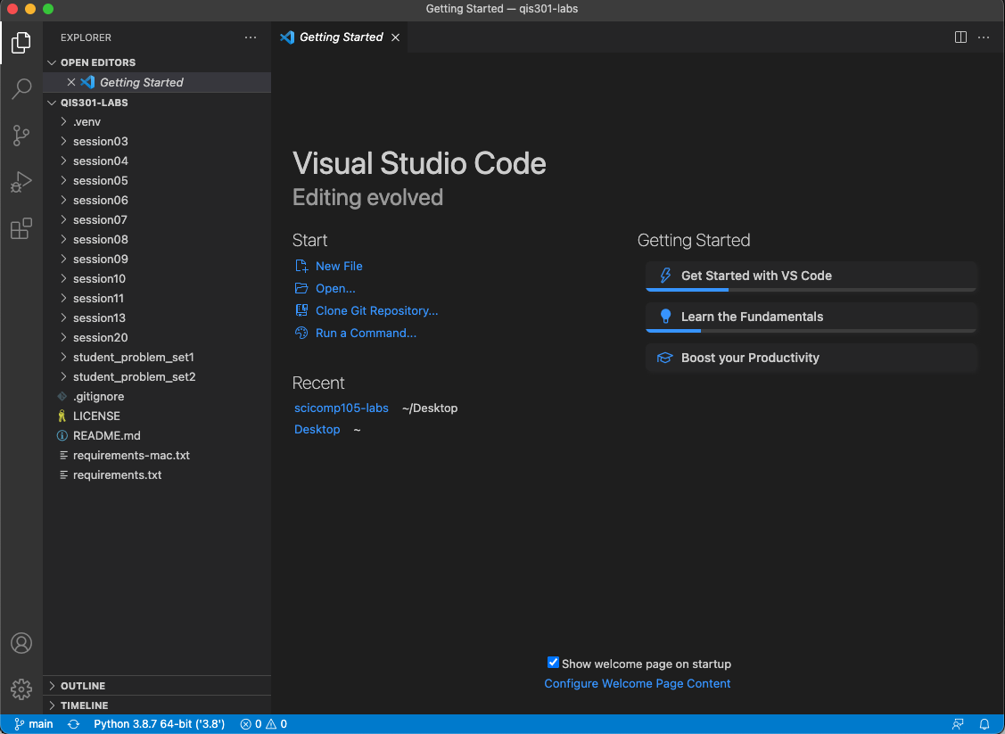
For macOS (all) Desktops
Success!

Slide 28
Configuring Visual Studio Code Extensions
VSCode is essentially just a free text editor
Powerful capabilities are added via third-party extensions
Extensions can be downloaded directly from within VSCode
In this workshop you will need four VSCode extensions:
Python – allows VS Code to run and debug Python scripts
Pylance –semantic (color syntax) highlighting for Python
Code Spell Checker – A basic spell checker for English words
Visual Studio IntelliCode - AI-assisted IntelliSense for code

Slide 29
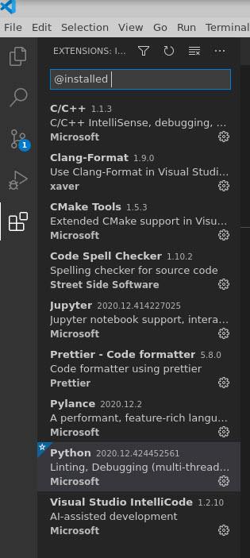
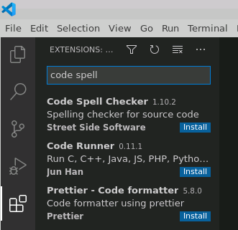
Configuring Visual Studio Code Extensions
Click on the Extensions button to install extensions
Just type the extension name, then click the blue Install button:

Slide 30
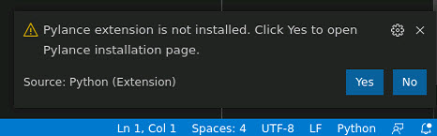
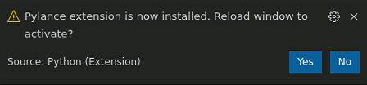
Configuring Visual Studio Code Extensions
When you open a source code file, VS Code may suggest extensions designed to handle that file type
When you open a ".py" (Python script) file, VS Code may automatically ask if you wish to install the Python and then Pylance extensions – just click Yes both times
After installation, some extensions may require you to restart (reload) VSCode

Slide 31
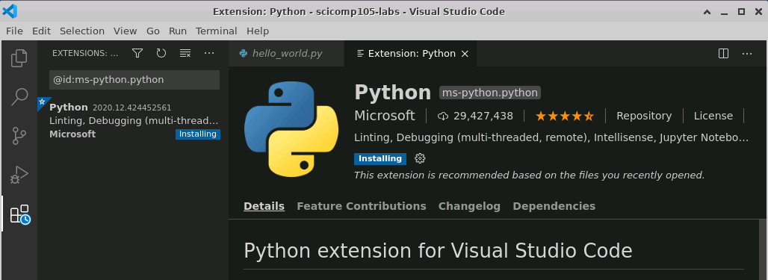
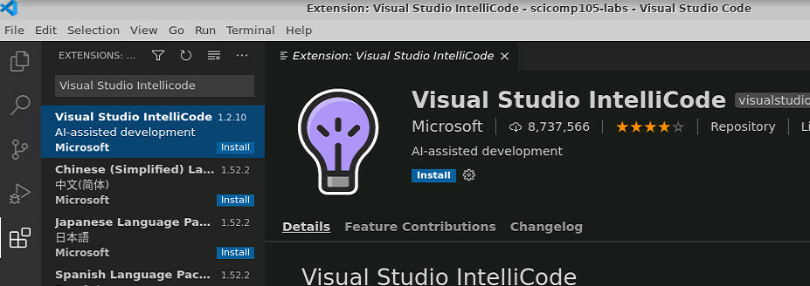
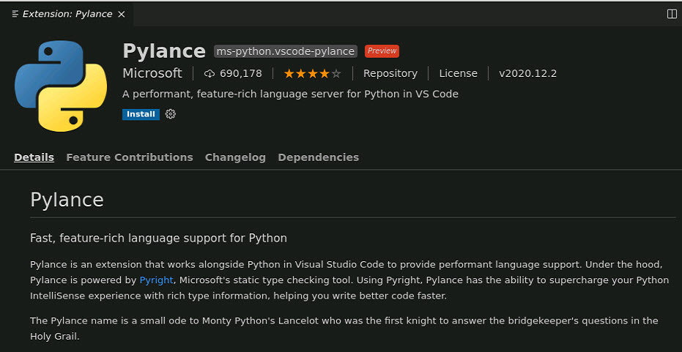
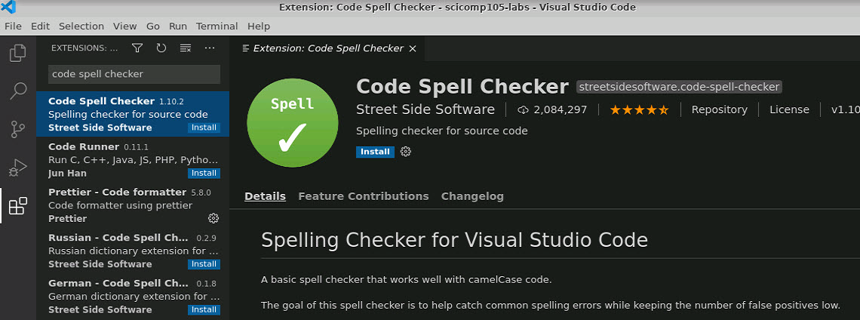
Configuring Visual Studio Code Extensions
Ensure you install these four extensions into your Visual Studio Code application

Slide 32
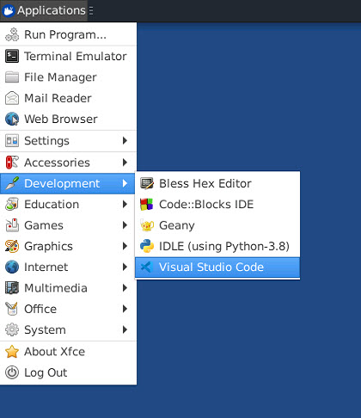
Opening qis301-labs folder in VSCode
Launching VS Code on the Linux (Xfce) desktop

Slide 33
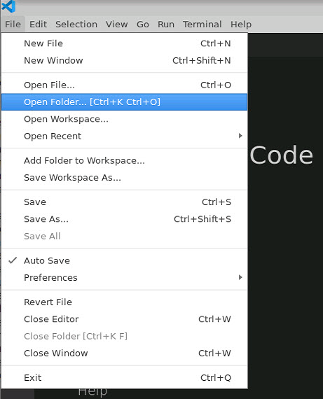
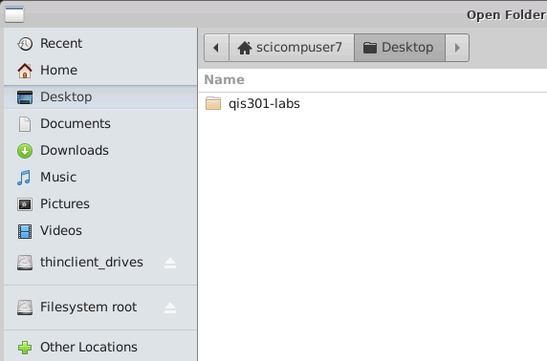
Opening qis301-labs folder in VSCode
This example shows opening a workspace folder in VS Code on Linux (Xfce)

Slide 34
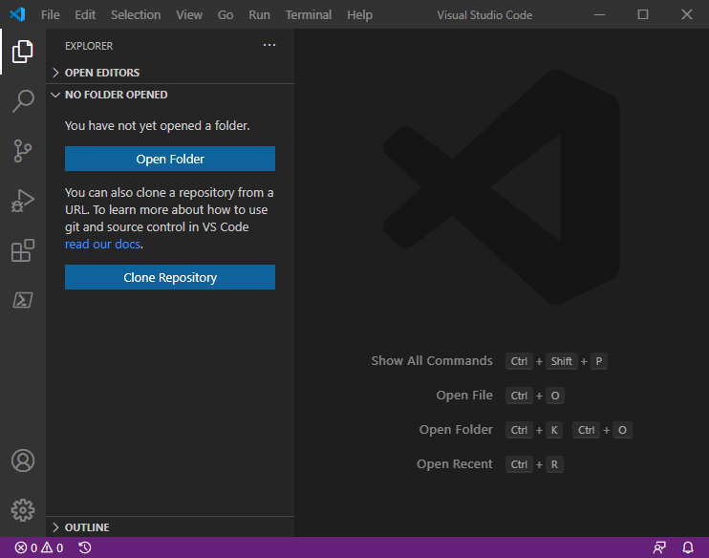
Opening qis301-labs folder in VSCode
Opening a workspace folder from within
VS Code itself

Slide 35
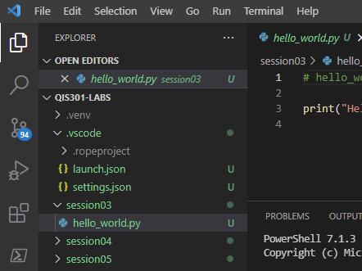
Opening qis301-labs files in VSCode
Within the workspace, the files tab will show you a subfolder for each QIS301-LABS session, along with the Python scripts for that session
Double click on a *.py file to open the script in the main editor window

Slide 36
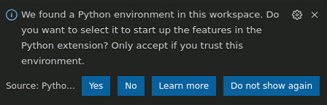
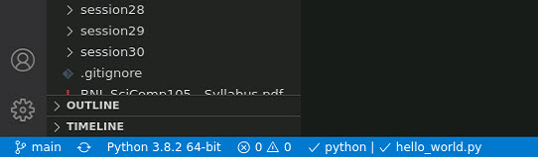
Configuring Visual Studio Code Extensions
The first time you open a Python source file (.py) in a workspace, VSCode may need help finding the Python virtual environment (venv) you created back in slides 11 – 22
This is not the right venv for this workspace
It might also assume an incorrect venv
You can fix this…

Slide 37
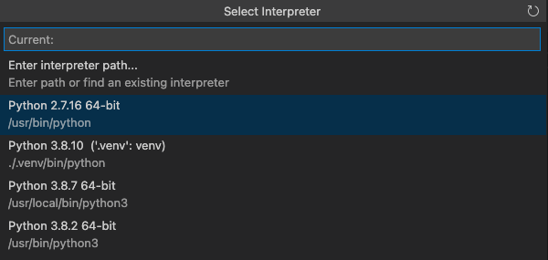
Configuring Visual Studio Code Extensions
VSCode may suggest other available virtual environments
But click on the one with the path ./.venv/bin/python
This is the right venv for this workspace!

Slide 38
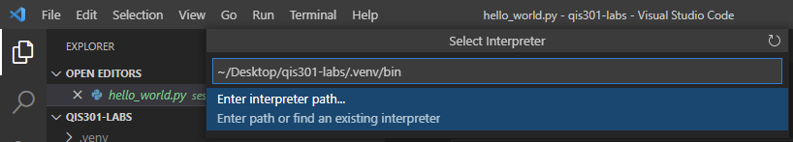
Configuring Visual Studio Code Extensions
On Windows, you might have to manually specify the full path to the virtual environment for this workspace
Enter ~/Desktop/qis301-labs/.venv/bin

Slide 39
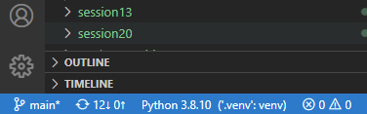
Configuring Visual Studio Code Extensions
You'll know the environment is set correctly when you see this at the bottom left of the VS Code window:
This is the right venv for this workspace!
Placing the workspace virtual environment in a project subfolder called .venv is a common practice
You should only have to set this once per workspace

Slide 40
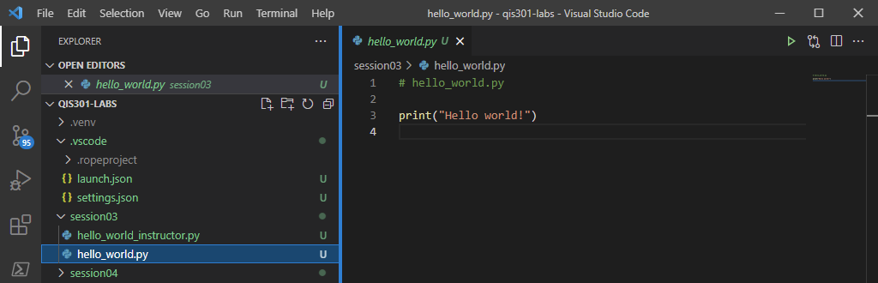
Running a Python Script in VSCode
To execute a Python program in the workspace, click the green arrow in the top-right of the editor window
You can also run the program in the debugger by pressing F5

Slide 41
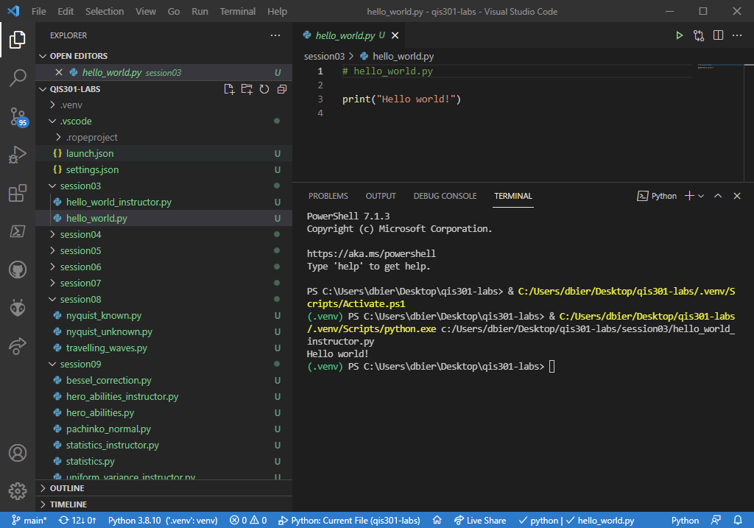
Running a Python Script in VSCode
☺

Slide 42
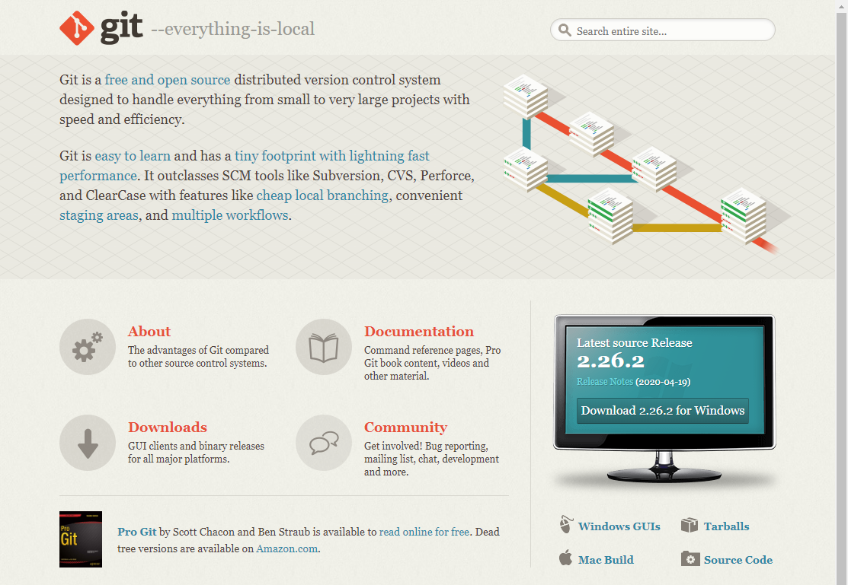
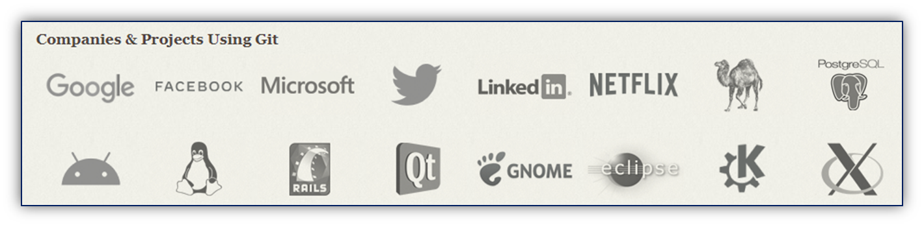
Learning Git
https://git-scm.com

Slide 43
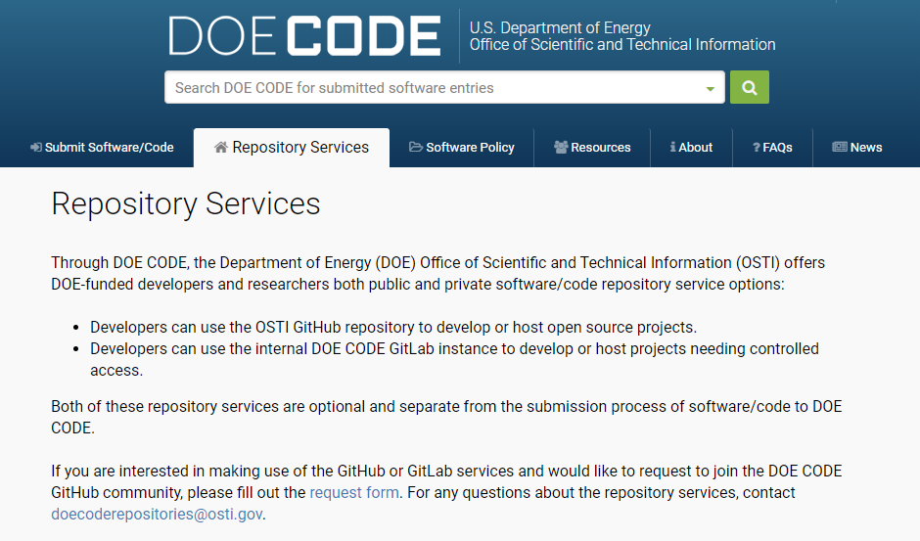
Learning Git
https://www.osti.gov/doecode

Slide 44
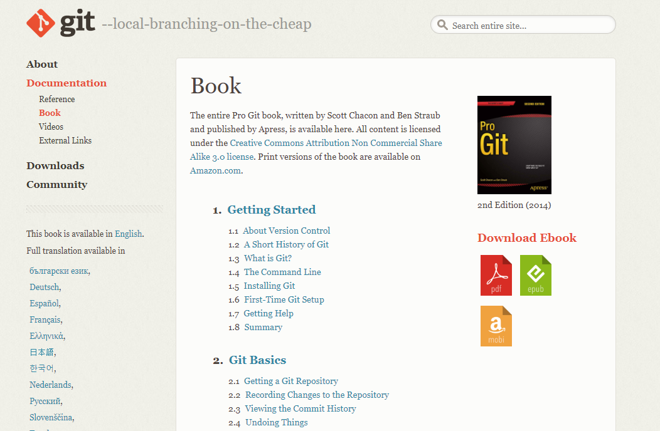
Learning Git
https://git-scm.com/book/en/v2

Slide 45
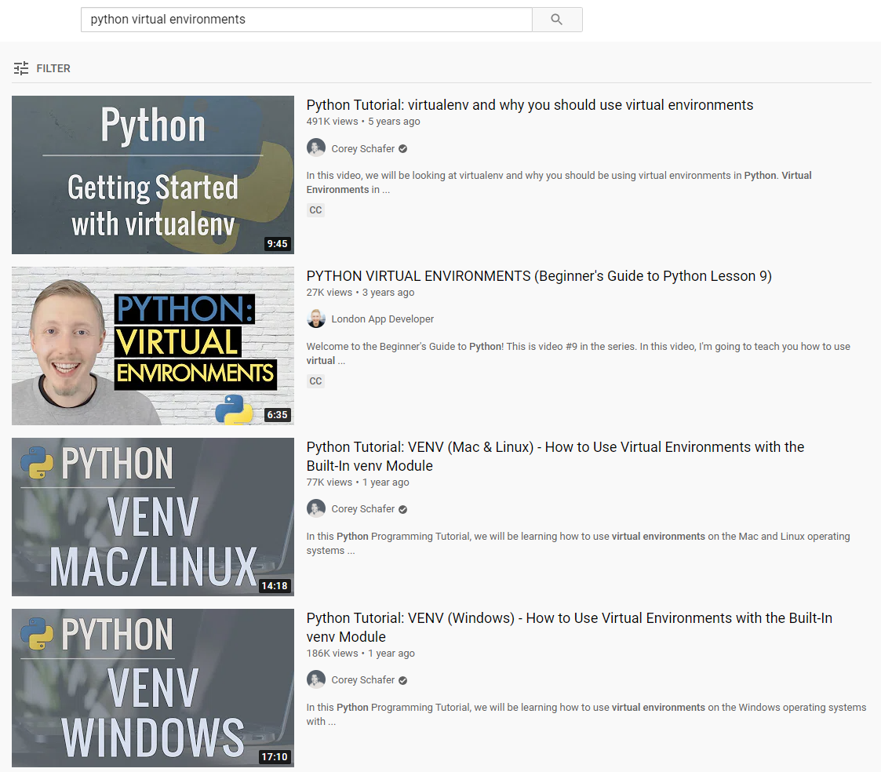
Learning Python Virtual Environments
https://www.youtube.com/results?search_query=python+virtual+environments

Slide 46
Closing Thoughts
Try to get the software installed locally on your own PC – don't get scared or give up in the face of initial difficulties
You are not alone, use Google search for hints
However, if you cannot get it to work on your own PC, don't worry!
BNL has provisioned a Linux-based PC in Amazon's cloud for each student that you can use for the duration of this course
All the required software is already installed on your remote PC
However, you should continue to view the PowerPoint slides for each session on your local PC because the remote PCs do not have Microsoft Office installed
I highly recommend you get this working on your own PC!

